Slide 1


AutoSort-AI-Powered Email Categorizer
Machine Learning
Attia Batool (22-cp-79) ,Amna Shehzad (22-CP-85)
14, May 2025

Slide 2
Problem Statement
Email inboxes receive a mix of spam, work, and personal messages.
Manually sorting these emails is time-consuming and error-prone.
There is a need for an automated system to classify emails into Spam, Work, and Personal categories.

Slide 3
Project Objective
To build a machine learning-based classifier that automatically detects and labels emails as:
Spam
Work
Personal

Slide 4
Machine Learning Technique Used
we used a Supervised Learning technique to classify emails into categories such as Spam, Work, and Personal.
The specific algorithm applied is the Multinomial Naive Bayes Classifier, which is particularly effective for text classification tasks due to its simplicity and performance on bag-of-words data representations.

Slide 5
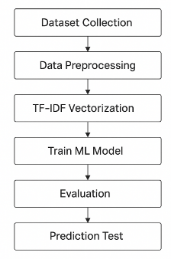
Methodology

Slide 6
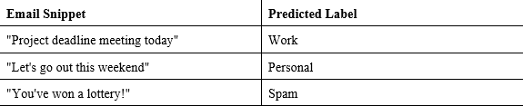
Results
The model was able to accurately classify emails into the 3 categories.

Slide 7
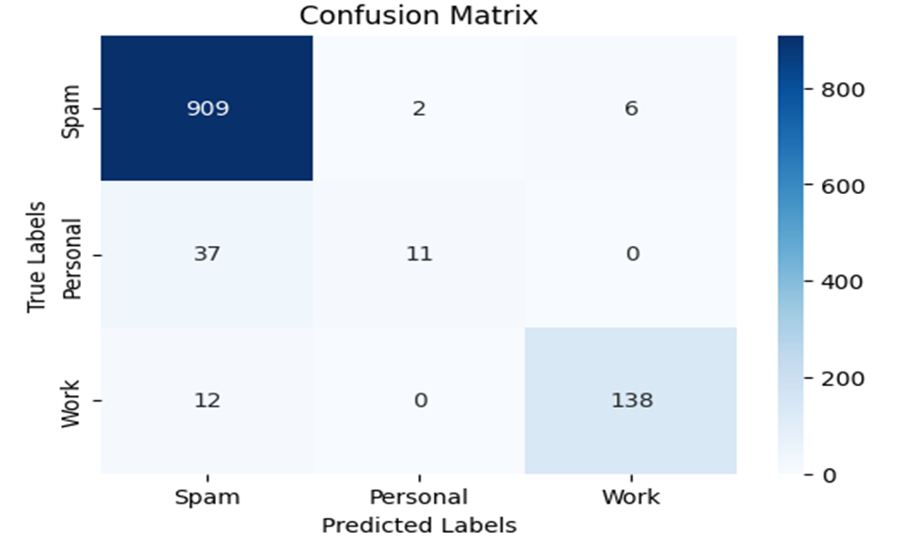
Contd..
Confusion matrix showed correct and incorrect predictions.

Slide 8
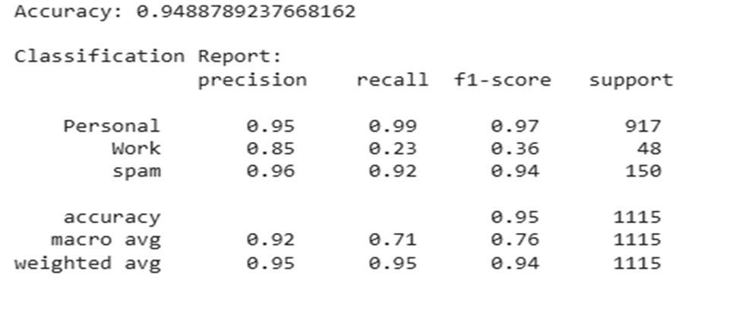
Contd..
Classification report included:

Slide 9
Conclusion
The implemented machine learning model effectively classifies emails into Spam, Work, and Personal categories.
This can improve email management and save time for users.

Slide 10
Future Work
Use deep learning models (like LSTM or BERT) for better accuracy.
Include more classes like Promotions, Updates, or Social.
Build a user interface (web app) for real-time email classification.

Slide 11
Thank you

